Slide 1


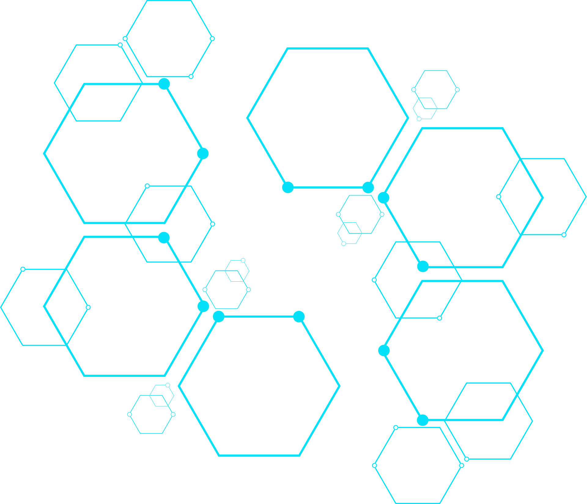
Azure Tagging Solution-
Reusable Automation Approach
Automation is not about replacing humans — it’s about empowering them to do more meaningful work.
Presented By
Amit Gupta

Slide 2



Introduction
Tagging is a foundational practice in cloud governance that involves assigning key-value pairs to resources for better management, visibility, and control. Tags help categorize resources based on purpose, ownership, environment, cost center, compliance, and more.
01
In large-scale cloud environments, where hundreds or thousands of resources may exist, tagging enables:
Efficient cost tracking
Automated policy enforcement
Simplified reporting and audits
Faster incident response and troubleshooting
Better resource organization and lifecycle management
02
A well-implemented tagging strategy ensures that organizations maintain clarity, accountability, and operational efficiency across their cloud infrastructure.

Slide 3


🚨 The Problem Faced
Managing and maintaining tagging compliance across cloud environments was a growing challenge. Some of the key issues we identified:
Lack of consistent tagging standards across subscriptions
Duplicate or redundant tags with the same purpose but different keys (e.g., Owner vs ownerName)
Missing mandatory tags on critical resources, causing non-compliance in audits
Manual tagging processes that were error-prone and time-consuming
Difficulty in tracking changes and ensuring rollback capability
Tag Cleanup
These issues resulted in low tagging compliance (around 40%)
and made reporting, cost tracking, and policy enforcement difficult.

Slide 4

🛠️ The Solution: Automated Tagging Script
To address these challenges, I developed a reusable PowerShell-based tagging script that automated the entire tagging lifecycle — from discovery to remediation and rollback.
Rollback Capability
If at any point a rollback is required (e.g., due to incorrect tagging or customer request), re-run the Update script with the original backup file.
The script will reapply the original tags to all resources, ensuring a quick and safe restoration.

Slide 5


Tagging Solution – Three-Step Process
Tag Backup
Run the first script (TagBackup.ps1) to capture all existing tags from the
environment.
The script exports all tag details of resources and resource groups into
an output file.
This file acts as a backup and reference point.
Validation and Update
Share the output file with the FinOps/CSR team for validation.
The team will:
Fill in missing mandatory tags
Correct duplicate or redundant tags
The same file, once updated, will be used as the input to the second script.
Apply Tags
Run the second script (TagUpdate.ps1) using the updated file.
The script will apply all tags as per the provided data.
This step ensures uniform, validated, and compliant tagging across the environment.

Slide 6


Benefits
Fully automated and repeatable tagging process
Improves compliance and simplifies audits
Reduces manual errors and inconsistencies
Provides a controlled, trackable way to manage tag changes
Can be implemented in any subscription/account without modification
After implementing this process/script, tagging compliance rose to over 95%, with minimal manual intervention.

Slide 7

Thank You
I believe this tagging automation will significantly enhance consistency and governance in any Azure environment.
Presented By
Amit Gupta

